Slide 1

Lonestar Cooking Club
Bringing delicious to life!

Slide 2
Sharing our joy of cooking since 2020
Our purpose is to teach cooking skills using a variety of methods to prepare healthy meals in an enjoyable way.
Join our Za'nya Wallace Lautaro Putallaz Zero Labrecque
Current Sebastian Gallego Jessica Keith
members: Lora Abousaway Jessica Geale

Slide 3

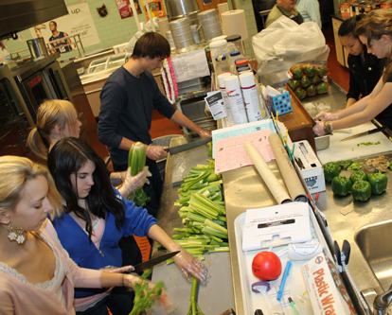

Annual Cookoffs
Work as a team at our Annual Cookoff with one of our chefs!

Slide 4
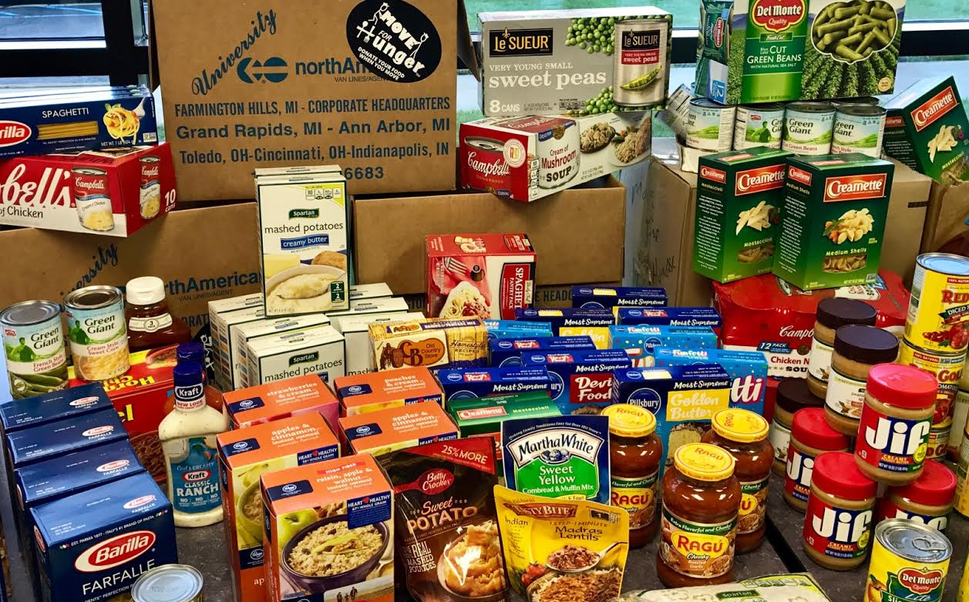
Community
Service
Join us in helping at our community food drive!

Slide 5

Come Join Us!
Tuesdays & Thursdays
1pm – 2:30pm
CASA Building
Room 132

Slide 6

For more information about our club and / or membership inquiries, please contact us:
By Phone: 713-867-5309
By Email: LonestarCooking@gmail.com
Or visit our website: https://lonestarcookingclub.family.blog/

